Slide 2
Intelligent Apps Using Cognitive Services
Michael Lanzetta
Principal SDE

Slide 3
Session Goals
Cognitive Services
Overview of Microsoft Cognitive Services Suite
Focus on Vision and LUIS
Azure Services
DocumentDB – a Great NoSQL PaaS Store
Azure Search – Intelligent PaaS Search on your own data
Bot Framework
Integrating Azure Search and LUIS
Working Code!
Finish the day with working code you can build upon
Notes:
This slide is required. Do NOT delete. This should be the first slide after your Title Slide.
This slide should describe what your goals are for this session. This information lets your audience know what you are trying to accomplish with your talk or tutorial—ie, what value will attendees get by investing 25 minutes or 2 hours of their time listening to you.
You should not spend more than 1 minute presenting this slide.
General examples of session goals could be (you will have to create your own specific goals):
Introduce a new technique or approach to solve a customer problem
Compare two approaches and explain why one is superior
Describe a project and the learnings that audience members can apply from it
Teach audience members how to use a specific technology

Slide 4
Agenda
Overview and Scenario
Phase 1 + Lunch – 11:00 – 2:15
Phase 2 – 2:15 – 3:30
Phase 3 – 3:30 – 5:00
Concluding Remarks

Slide 5
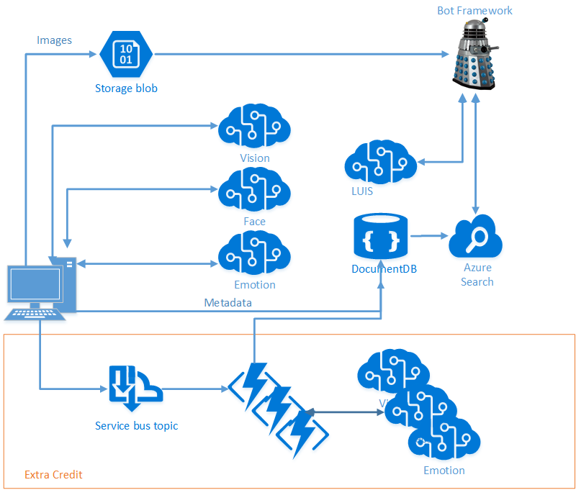
Scenario
Intelligence from Images
Vision Services
Cloud Storage
Search
Conversation and Language Understanding

Slide 6
Agenda
Overview and Scenario
Phase 1 – 11:00 – 2:15
Tour of the Cognitive Services and DocumentDB
Hands-on – Calling Vision Services, Writing to DocumentDB
Phase 2 – 2:15 – 3:30
Tour of Azure Search
Hands-on –Building and Querying an Index
Phase 3 – 3:30 – 5:00
Tour of the Bot Framework
Hands-on – Building a Query Bot
Concluding Remarks

Slide 7
Setup
Azure Pass
Take a look at your Azure Pass guide
Log into Portal
Visual Studio: Don’t have it? Deploy a VM!
Code
Go to our GitHub Repo: https://github.com/noodlefrenzy/CognitiveServicesTutorial
Clone Locally
Load up LabManual.md
Code for all tracks is available at: https://github.com/Microsoft/AI-Immersion-Workshop

Slide 8
Code Repository Structure
LabManual.md has all directions
“Starting” directory has “boilerplate” code
Too much to do in one day, so we’ve done the annoying bits
Once you’re home, feel free to start from scratch – we accept PRs ☺
“Finished” directory has completed code
Useful to correct your direction
Feel free to pull from this if you start running behind
“sample_images.zip” contains some samples for use
Feel free to use your own

